Slide 1
Sorting Algorithm Visualizer
Presented by:
E019 – Ishaan Kangriwala
E020 – Paarth Kapasi
E035 – Dhruv Patel
E050 – Nihal Shetty
Mentor: Prof. Mohini Reddy

Slide 2
Outline
Introduction
Problem definition
Literature review in brief (2 slides)
Algorithms /Architecture
UML Diagrams(Usecase, Sequence, Class Diagram)
Implementation Plan
Action plan for rest of the Project
Conclusion & Future work
References

Slide 3
Introduction
We have always studied algorithms with a mathematical and empirical approach, but there is a third way to study algorithms, called algorithm visualization and it can be defined as the use of graphical tools to convey some useful information about algorithms.
So, why visualize algorithms? Why visualize anything? To leverage the human visual system to improve understanding. Or more simply, to use vision to think.
It can be a visual illustration of an algorithm’s operation, of its performance or of its execution speed.
Often we fail to understand the core idea of a particular algorithm maybe because we are unable to visualize how they work.
So the most important thing to understand about these algorithms is visualization.

Slide 4
Problem Definition
This project aims to demonstrate the working of various sorting algorithms in a graphical manner for better understanding of the working of said algorithms

Slide 5
Literature Review
Paper | Description | Features & Drawbacks
Secondary education students’ difficulties in algorithmic problems with arrays: An analysis using the SOLO taxonomy | This paper presents the results of an empirical study on secondary education students’ misconceptions and mental representations of the array data structure. It infers that many students under the study had incomplete or faulty representations of the array concepts, which led to difficulties in understanding algorithmic problems The issue seemed to be connected to their misconceptions about the programming variable concept. | It was found that students face difficulty in judging the type of problems that require to use an array in their solution algorithm The results presented in this paper could be of value for the design and the successful implementation of new learning environments that support students’ algorithmic thinking, as well as the development of appropriate mental models about basic programming entities.
Design and evaluation of a web-based dynamic algorithm visualization environment for novices | This paper presents DAVE, a web-based dynamic algorithm visualization environment designed to support students’ learning about basic algorithms. DAVE facilitates students’ experimentation with array algorithms. | The results obtained from an evaluation study, provide evidence of the usability of the system and its potential to support students’ development of efficient mental models regarding basic array algorithms.In addition, students were positive about the environment, its usability and its usefulness to support their learning. The main drawback of the proposed system in this paper is that the visualization is in a list format which itself can be confusing.
Notes:
2nd paper drawback: The UI is more focused on the changes in the array elements rather than the visualization of the algorithm.

Slide 6
Literature Review
Paper | Description | Features & Drawbacks
Visualizing Sequence of Algorithms for Searching and Sorting | In this paper sequence of execution of algorithms are explained visually in an interactive manner. It helps to realize the fundamental concept of algorithms such as searching and sorting method in a simple manner. | Comparisons of the time complexity of the steps have been carried out. The system proposed in the paper is interactive for better user experience. The papers fails to document images of the UI of the proposed system making it difficult for the reviewers to gauge the effectiveness of the system The papers makes the claim that the application improves the perspective of algorithms but fails to incorporate the users’ feedbacks to support the same.
ViSA: Visualization of Sorting Algorithms | This paper describes ViSA, a tool for visualization of sorting algorithms. ViSA is an easy-to-set-up and fully automatic visualization system with step-by-step explanations and comparison of sorting algorithms. Design principles and technical structure of the visualization system as well as its practical implication and educational benefits are presented and discussed. | Visualization of sorting algorithms (ViSA) offers a full range of functionalities such as data set entry and animation control as well as the explanation and detailed algorithm analysis. Using ViSA, the learning curve and time spent learning and understanding should be significantly reduced. Although the paper and the system proposed have been executed well ,there is no option to store the results.
Notes:
2nd point continuation :ViSA creates a bridge between students and algorithms in a manner that removes the need for writing the programming code, thus reducing the fear of programming. Once they have familiarized themselves with the algorithm, students would access programming with much more confidence. ViSA is perceived as an educational tool whose usefulness and ease of use contribute to a positive attitude and behavioral intention regarding its use.

Slide 7
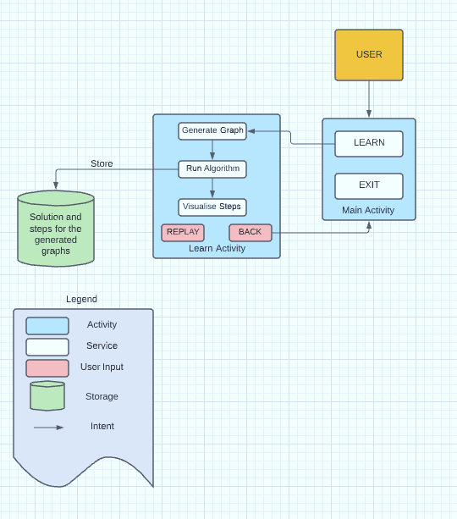
Architecture

Slide 8
Algorithms
The algorithms used in the project are as follows:
Selection Sort
Insertion Sort
Merge Sort
Bubble Sort
Quick Sort

Slide 9
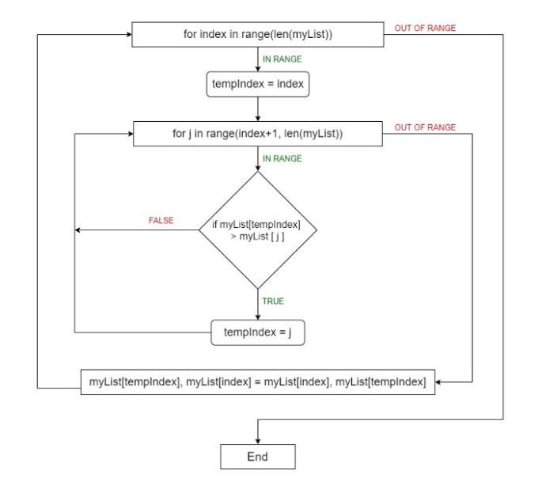
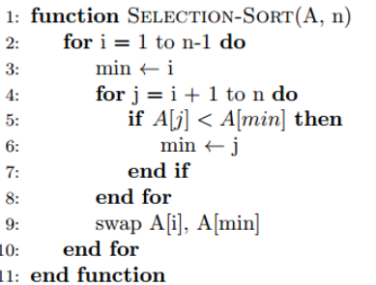
Selection Sort

Slide 10
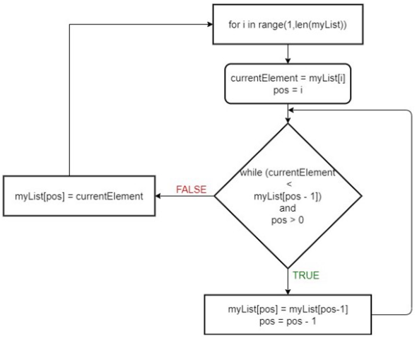
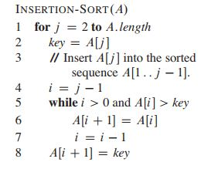
Insertion Sort

Slide 11
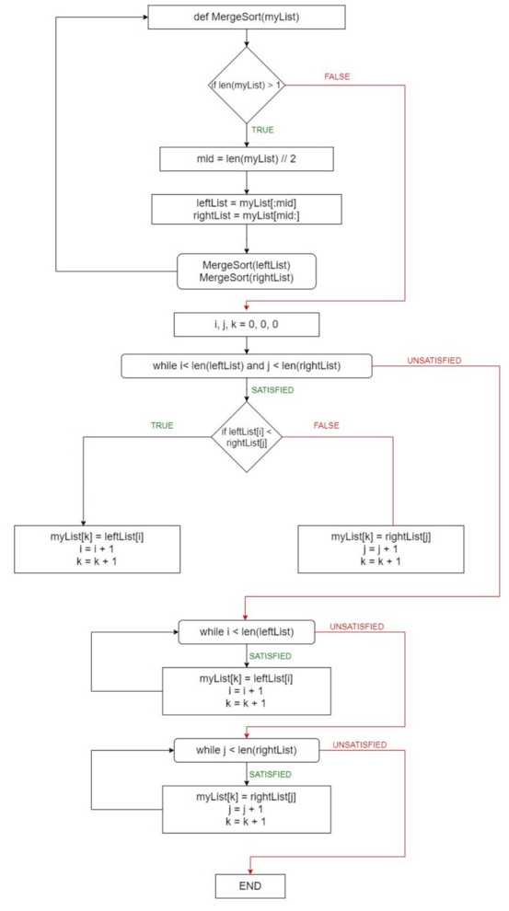
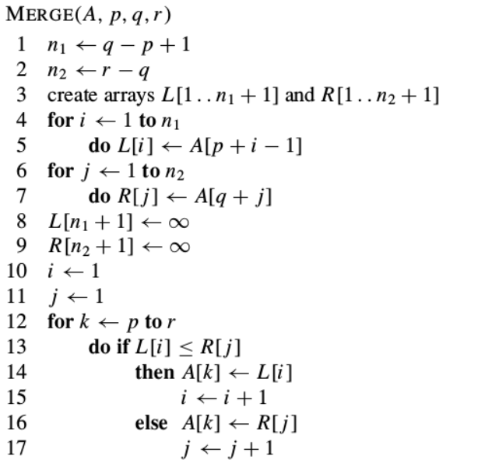
Merge Sort

Slide 12
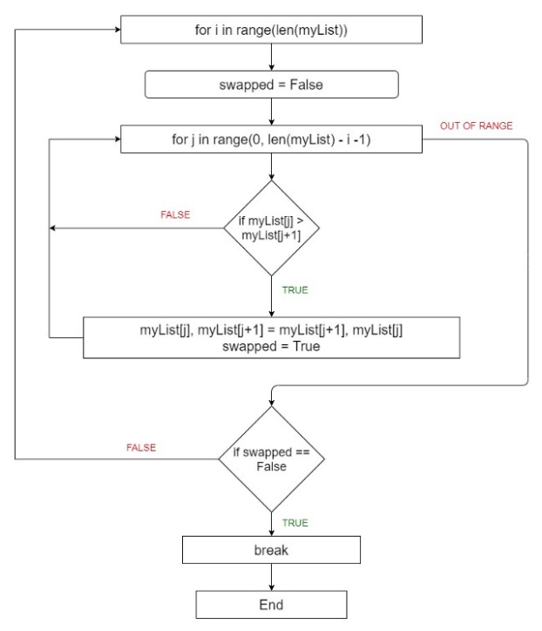
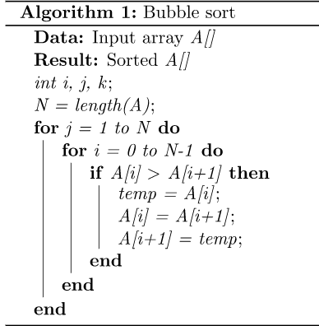
Bubble Sort

Slide 13
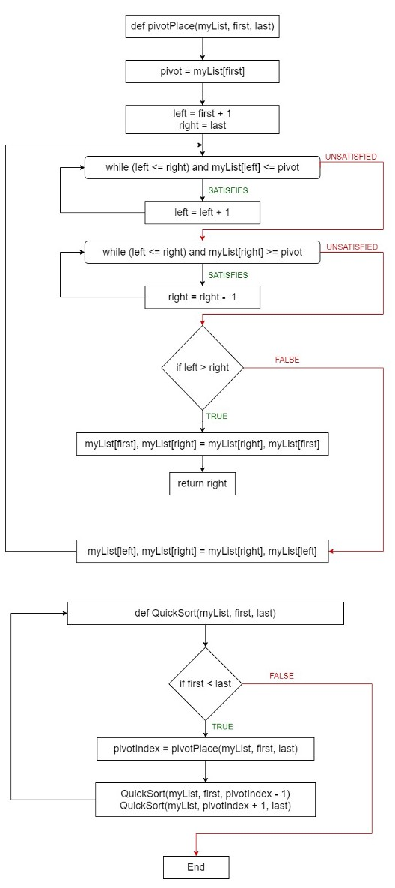
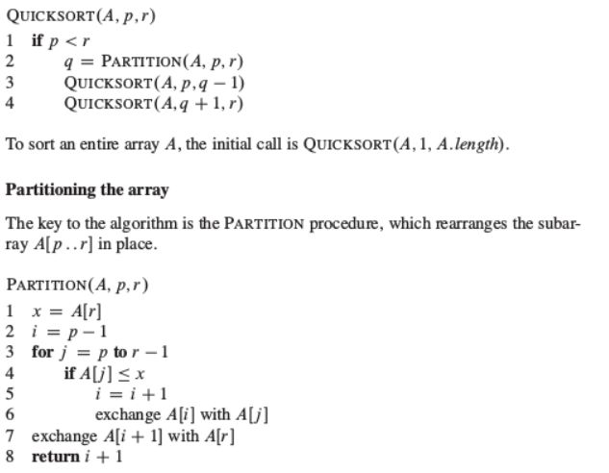
Quick Sort

Slide 14
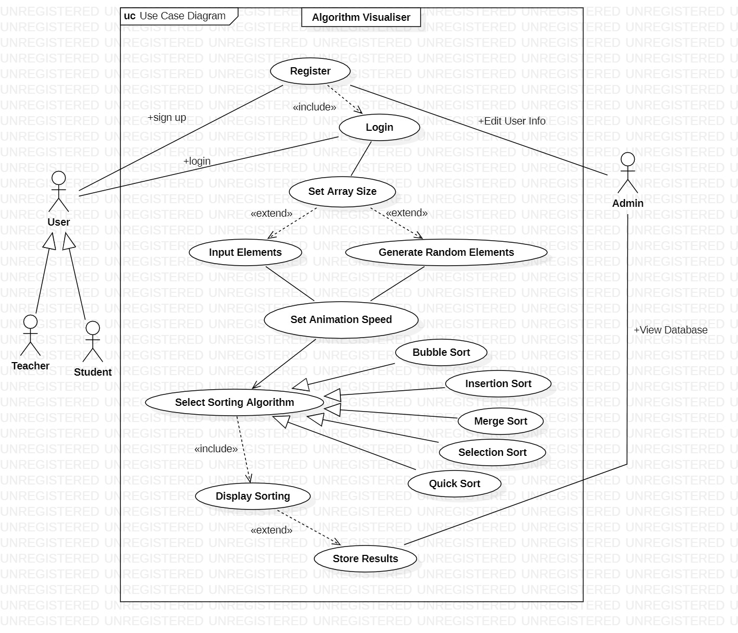
UML Diagrams - Use Case

Slide 15
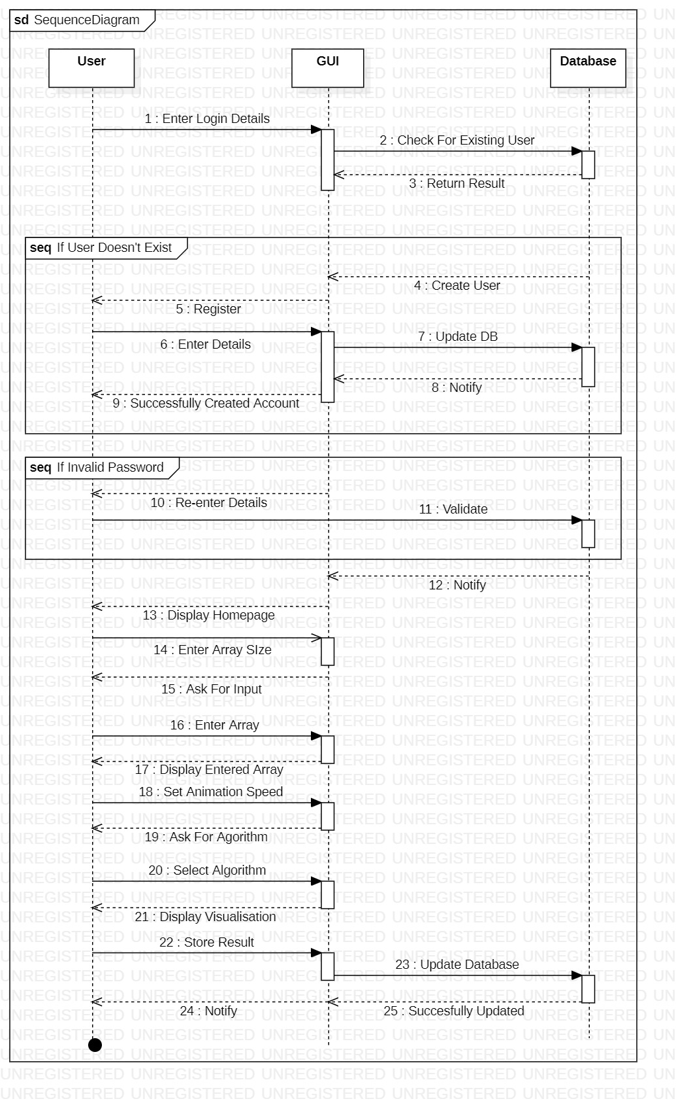
UML Diagrams - Sequence

Slide 16
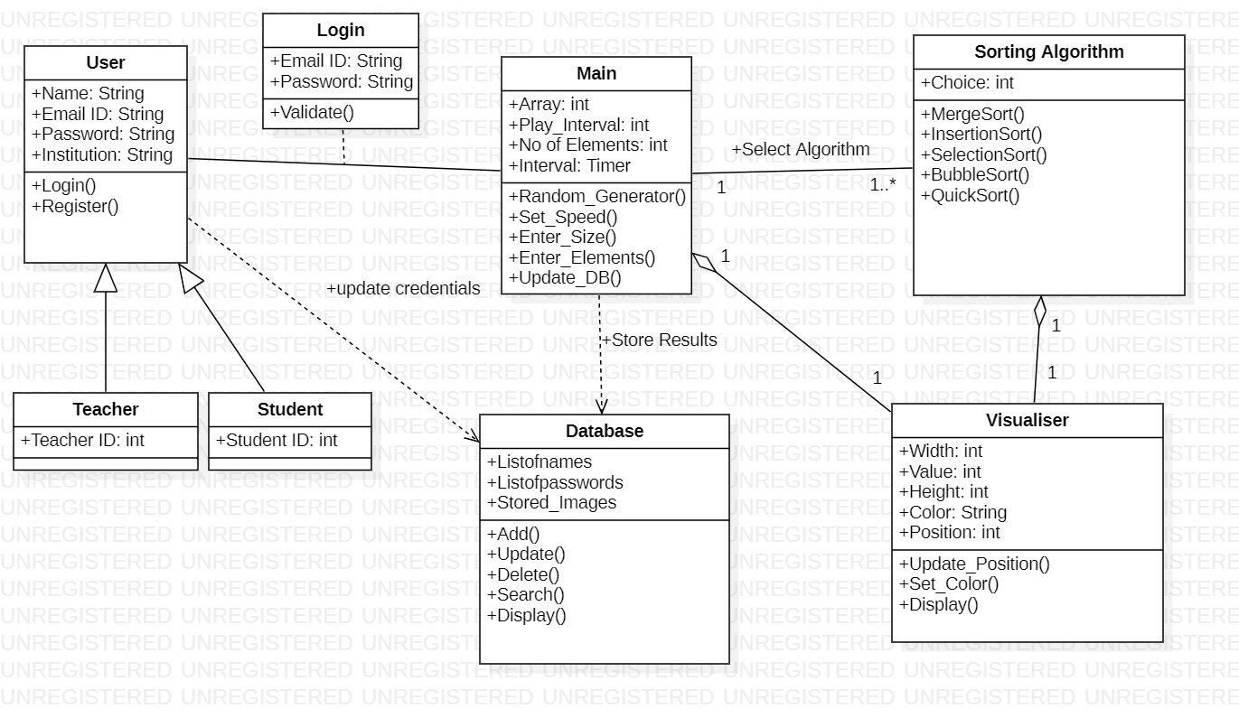
UML Diagrams – Class

Slide 17
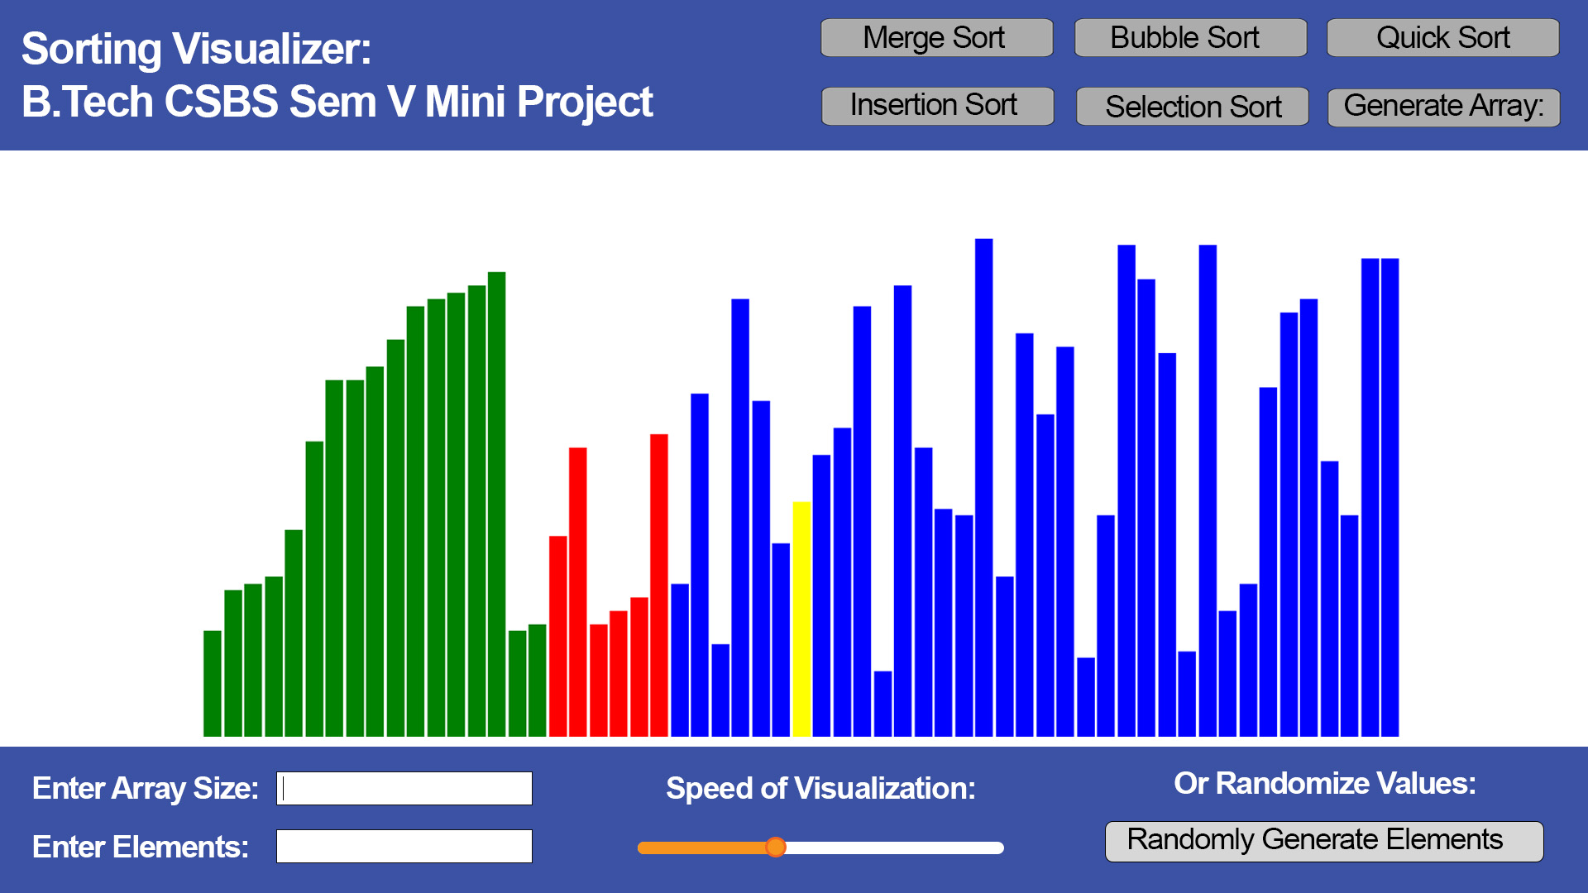
Proposed UI/Design

Slide 18
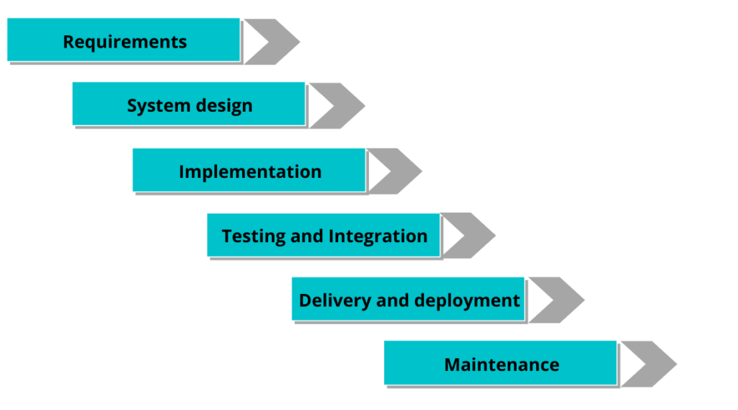

Implementation Plan
Setup server environment using XAMPP and PHP.
Implement backend , consisting of algorithms using JS.
Design and develop frontend using HTML and CSS.
Integrate backend and frontend by setting up the database using phpMyAdmin and generating a sql connection in the main file.
Test the visualizer using random as well as custom inputs to check for error.

Slide 19
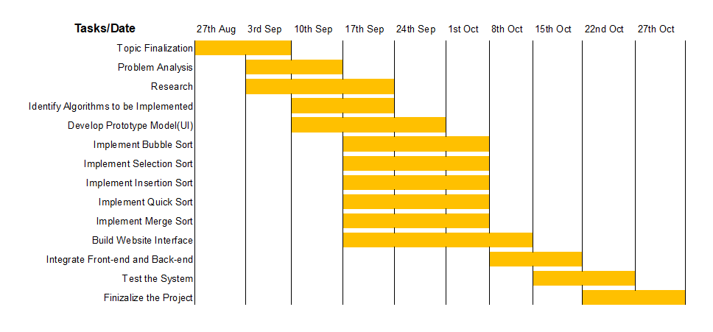
Action plan for rest of the Project

Slide 20
Conclusion & Future work
Students usually face difficulties in understanding the concept of algorithms which involve arrays.
Algorithm visualiser is a proven way to assist students in understanding these concepts.
Over the course of this project, we will be learning to implement algorithms visually which would require a detailed understanding and examination of said algorithms.
This would not only help us understand them better, but also help future students topics to get a better grasp over them.
For our project we aim to implement the visualiser using HTML, CSS and JS as they are useful in developing application with interactive UIs.
In the future, we could implement this project using ReactJS as it opens up more opportunities to develop complex algorithm visualisers like Prims, Dijkstra's, Pathfinder, etc. We would also like to work upon our UI , so as to make it more interactive as well as appealing to the users.

Slide 21
References
Euripides Vrachnos, Athanassios Jimoyiannis,Design and Evaluation of a Web-based Dynamic Algorithm Visualization Environment for Novices, Procedia Computer Science, Volume 27,2014,Pages 229-239,ISSN 1877-0509,https://doi.org/10.1016/j.procs.2014.02.026.
I. Reif and T. Orehovacki, "ViSA: Visualization of sorting algorithms," 2012 Proceedings of the 35th International Convention MIPRO, 2012, pp. 1146-1151.
Ashwani Kumar Singh and Danish Jamal and Pranjal Aggarwal, Algorithm Visualizer, EasyChair Preprint no. 5385, EasyChair, 2021.
B. R., R. V. and T. S., "Visualizing Sequence of Algorithms for Searching and Sorting," 2009 International Conference on Advances in Recent Technologies in Communication and Computing, 2009, pp. 647-649, doi: 10.1109/ARTCom.2009.20.
Faria, Brian, "Visualizing Sorting Algorithms" (2017). Honors Projects Overview. 127. https://digitalcommons.ric.edu/honors_projects/127.
Saraiya, Purvi & Shaffer, Clifford & Mccrickard, D. & North, Chris. (2003). Effective Features of Algorithm Visualizations. Proceedings of the SIGCSE Technical Symposium on Computer Science Education. 36. 10.1145/1028174.971432.
Hundhausen, Christopher & Douglas, Sarah & Stasko, John. (2002). A Meta-Study of Algorithm Visualization Effectiveness. Journal of Visual Languages & Computing. 13. 259-290. 10.1006/jvlc.2002.0237.
https://bost.ocks.org/mike/algorithms/
https://visualgo.net/en

